Slide 1
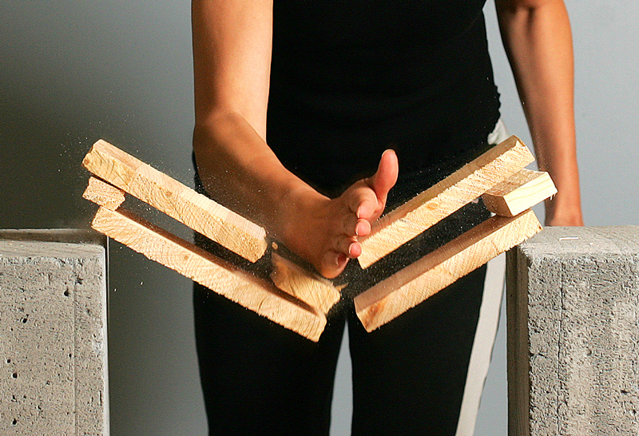
Newton’s Third Law of Motion
This lesson will introduce you to the third of three laws of
dynamics
These laws are the fundamental laws of Dynamics. With them, you
can predict how an object will move when under the influence of
forces.

Slide 2
Learning Goals
By the end of this lesson, you will be able to:
understand why forces always act in pairs
state and explain Newton’s 3rd Law of Motion
identify when the 3rd law applies in certain situation
solve problems involving the 3rd law

Slide 3
Success Criteria
Can I:
state and explain action and reaction forces
explain situations involving the 3rd law
apply the 3rd law to draw FBD’s and solve for the net force and acceleration of an object.

Slide 4
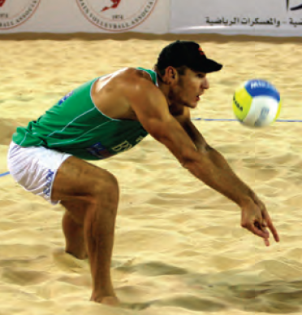
Force Exist in Pairs
Newton discovered that when two objects interact,
two forces will always be involved
These two forces are called action and reaction
forces
Can you identify the action – reaction forces in this diagram?

Slide 5
Newton’s 3rd Law of Motion
For every action force that object A exerts on object B, object B exerts a reaction force that is equal in magnitude, but opposite in direction on object A
Newton’s 3rd law of motion tells us that action-
reaction forces are
equal in magnitude
opposite in direction

Slide 6
Sample Problem
Draw the FBD of a 2.5 kg book resting on a table
Sol’n
Force of table on book
F_{N} = 25 N [U]
2.5 kg
Force of gravity on book
F_{g} = 25 N [D]

Slide 7
Sample Problem
State the reaction forces to the book in ex 1
Sol’n
There are two reaction forces, because there are two
Forces on the free-body diagrams.
If the table pushes on the book with 25 N [U],
then the book pushes on the table with 25 N [D]
If the Earth pulls on the book with a force of
25 N [D], then the book must pull on the Earth
with 25 N[U]

Slide 8
That’s Right. The book pulls on the earth with an
equal force, just opposite in direction.

Slide 9

Applications of the 3rd Law
1. Walking
When you walk, you apply a force to the earth (the action force). By Newton’s 3rd law the Earth will push back on you (the reaction force). The forces are equal in magnitude, but opposite in direction.

Slide 10
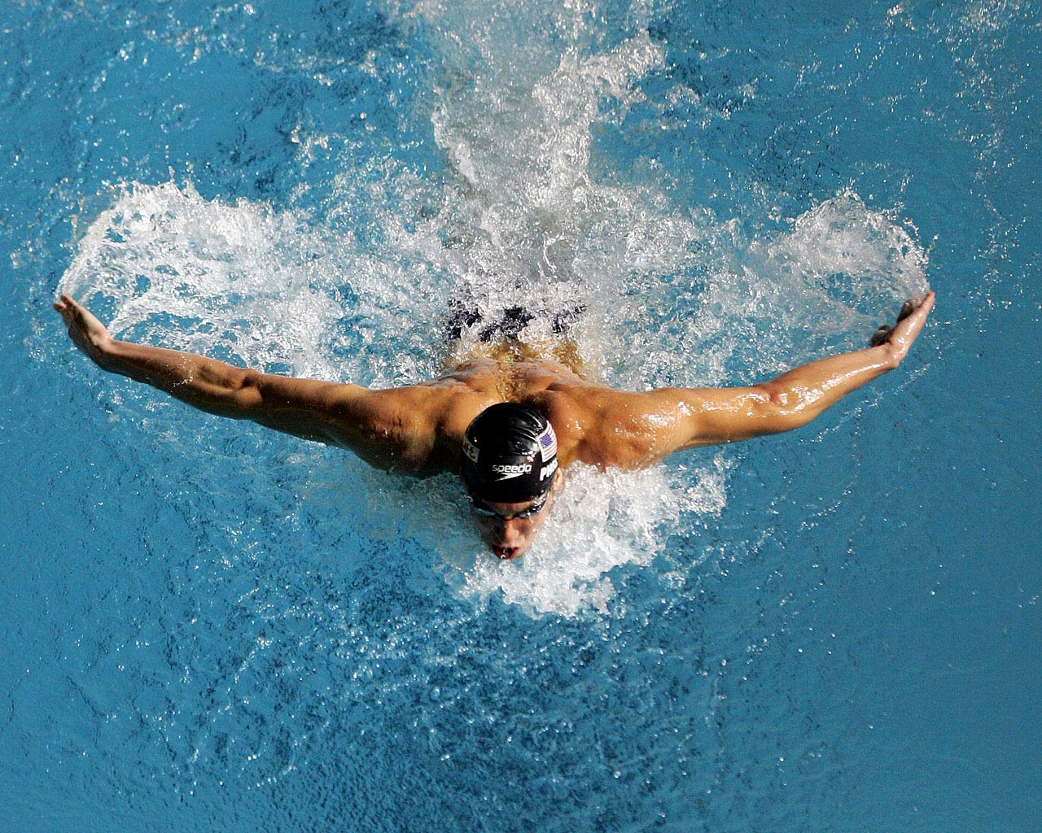
2. Swimming
When you swim, you apply a force to the water (the action force). By Newton’s 3rd law the water will push back on you (the reaction force). The forces are equal in magnitude, but opposite in direction.

Slide 11

Suppose you push on a box in order to move it across the floor.
The reaction force is the box will push back on you. If the box pushes back on you, then how are you able to push it.
Question: Why don’t action reaction forces cancel
each other out?

Slide 12
Answer: Because they act on different objects.
To understand this, lets Draw the FBD of each object
F_{N}
F_{f}
F_{a}
This is the action force, the
applied force by the person.
F_{g}

Slide 13
F_{N}
F_{a}
F_{f}
This is the reaction force, the force which the box pushes back on the person
F_{g}

Slide 14
HOMEWORK
Read Section 3.4
Review Tutorial 1 and 2
Questions 1 pg 138
1 – 4 pg 140
1 – 9 pg 141

